Slide 1
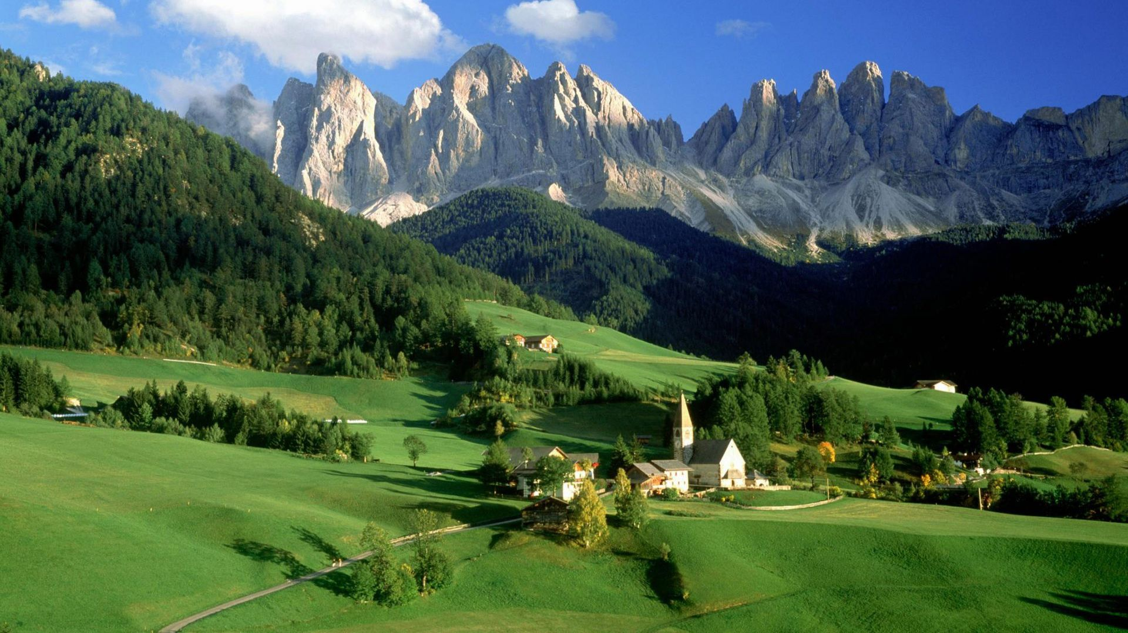

GIS mapping and modelling – top-down aggregation of data on collective action for conservation
Dr Sarah Cornell
Umeå, February 2015

Slide 2
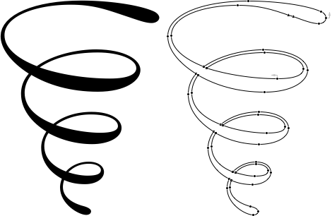
Ecological systems
persistence
adaptation
transformation
Resilience
learning
self-organization
coping capacity
Social systems
Notes:
Resilience focuses on undestanding change – and also on why some systems remain stable when everything else is changing.
We do not view social systems and ecological systems separately. We are particularly interested in the links and feedbacks between the systems. Change in one component system plays out in the other.
We work to integrate research from both the social and ecological domains – an evolving process.

Slide 3
We can view the proposed framework from COP12 Info Doc 7 through a resilience lens
Resilience approaches view social and ecological systems as linked and interdependent
The social and the ecological are both complex systems – simplifications are needed.

Slide 4
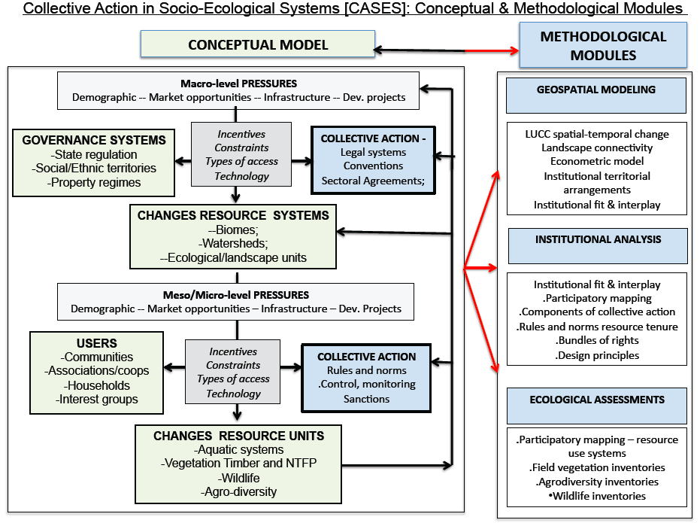
A different view of
Figure 2 in COP12 Info Doc 7:
Driving pressures in (wider) society
(demographics, markets, infrastructure, development projects)
Change in ecological state of resource systems
(landscapes, watersheds)
Formal governance systems
Collective action
DPSIR – OECD’s widely used framework for cause and effect relationships between society and environment
Impacts on (local) resource users and interest groups
Responses
(incentives, constraints, types of access, technology)
Changes in social and ecological processes ‘ping-pong’ through the system. They are shaped by formal governance institutions that are already recognized
and by collective action institutions that need to be recognized.

Slide 5
A different view of
Figure 2 in COP12 Info Doc 7:
Geospatial modelling
(geographic information systems models and maps + Earth observation)
Institutional analysis
(Elinor Ostrom’s framework on collective action and nested governance)
These responses can:
Change pressures
Change resource use
Change impacts
Ecological assessments
(including resilience of linked social-ecological systems)
Linking methodologies that cover each stage of the cascade

Slide 6
Image: http://vidici.grn.cc/
GIS mapping and modelling analyses target areas:
Suitable (flat, vegetated, etc.)
Accessible (near towns, roads, waterways, etc.)
Permissible (no government prohibitions on using the land)

Slide 7
Earth observation (remote sensing/satellite data) shows what is on the ground.
Where the model predicts degradation
and the observations show conservation –
is collective action the reason?

Slide 8
Social
Institutional
Ostrom’s IAD: Boundaries, Fit, Collective choice, Legitimacy, Nesting
Communities
Participatory mapping
Ecological
Ecological
Systematic surveys, rapid assessments, targeted interviews
Physical
GIS maps, models,
Earth Observation
We need to keep attention on methods that bring the complexity back into the simplification – especially because the world is changing (e.g. climate, pollution).
The PROCESS is as important as the maps and models.

Slide 9
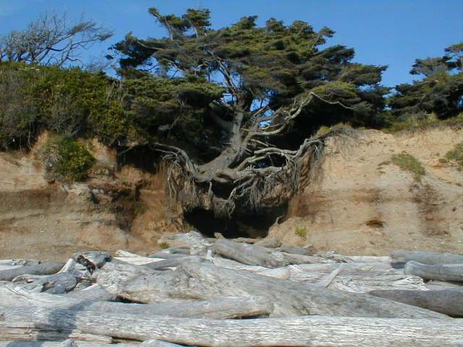
Image, https://www.flickr.com/photos/jamieca/31621961/in/photostream/
: © J. Campbell

